Slide 1
Session 8 Dynamic modeling
27410: Computer-aided cell factory design
Nikolaus Sonnenschein, Computer Aided Biotechnology Group
✉️
niso@dtu.dk
Notes:
Mention possibility of Specialization and M.Sc. projects after September

Slide 2
Learning objectives
After this lecture, you will be able to:
Discuss how Michaelis-Menten kinetics affect the metabolic flux through an enzymatic reaction.
Describe the use of Metabolic Control Analysis on a single metabolic pathway
Define the Flux Control Coefficient (FCC) (eq. 11.3) and the Flux Control Summation theorem (eq. 11.6) and explain verbally what that implies for a linear metabolic pathway.
Define the Concentration Control Coefficient (CCC) (eq. 11.9) and the Concentration Control Summation theorem (eq. 11.10) and explain verbally what that implies for a linear metabolic pathway.
Explain the general concept of Dynamic Flux Balance Analysis (DFBA) and how to apply it to model and simulate a batch cultivation

Slide 3
Agenda of the day
Enzyme kinetics (15 min; lecture)
Metabolic control analysis (MCA) (20 min lecture)
MCA in-class exercise (45 min)
Dynamic Flux Balance Analysis (10 min; lecture)
Exercise: Dynamic Flux Balance Analysis (remaining time)

Slide 4
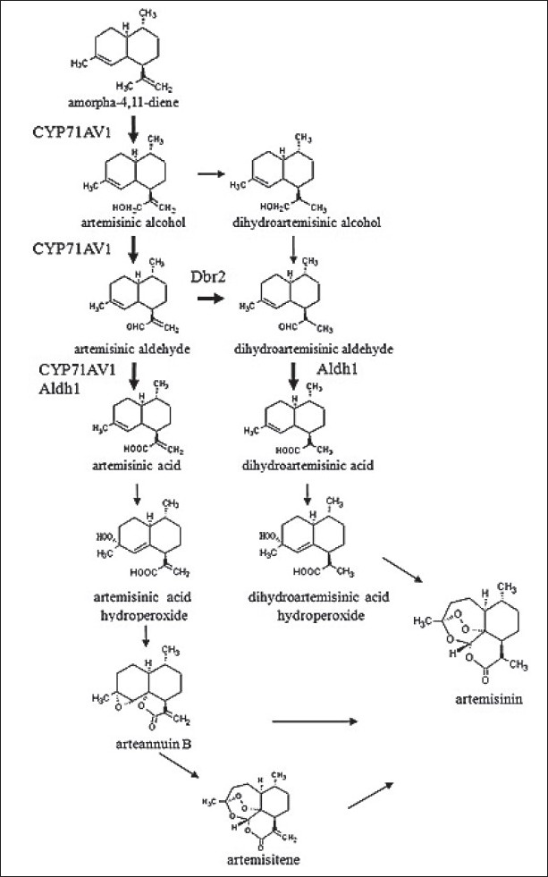
The challenge: How do we optimize a single pathway?

Slide 5
The challenge: How do we optimize a single pathway?
The flux J through a pathway is regulated by a number of things:
Enzyme kinetics
Affinity for substrate/product/inhibitors
Catalytic efficiency
Thermodynamics
Concentrations of metabolites
Genetic regulation
Expression of enzymes

Slide 6
Michaelis-Menten Kinetics

Slide 7
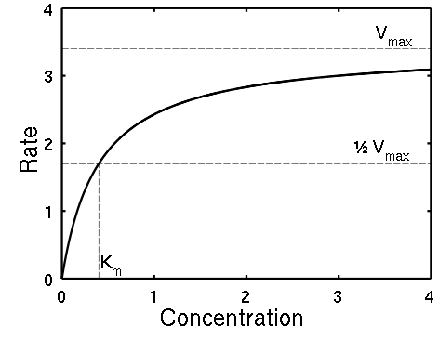
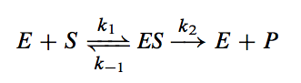
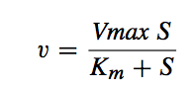
Basic Michaelis-Menten enzyme kinetics - The irreversible reaction
Given an enzymatic reaction with the enzyme E, the substrate S, the enzyme substrate complex ES, and the product P, we have:
It can be derived that the rate of the reaction v is:
[S]
Notes:
Take home: In some concentration spans, there is a large effect and in some, there is nearly no effect of delta[S]

Slide 8
Basic Michaelis-Menten enzyme kinetics - The irreversible reaction
Given an enzymatic reaction with the enzyme E, the substrate S, the enzyme substrate complex ES, and the product P, we have:
It can be derived that the rate of the reaction v is:
Leonor Michaelis
Maud Menten
Notes:
Take home: In some concentration spans, there is a large effect and in some, there is nearly no effect of delta[S]
German biochemist Leonor Michaelis and Canadian physician Maud Menten, who investigated the kinetics of an enzymatic reaction mechanism, invertase, that catalyzes the hydrolysis of sucrose into glucose and fructose.

Slide 9
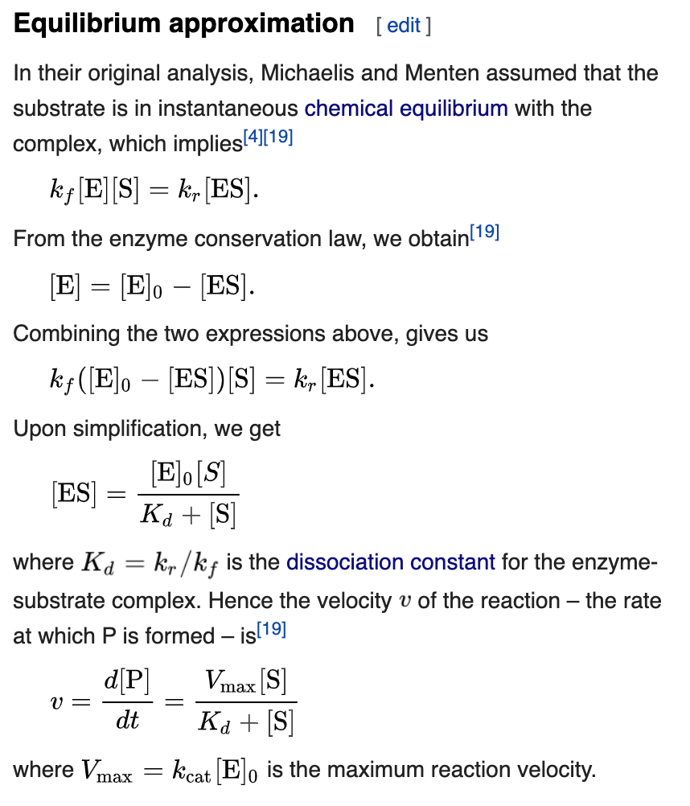
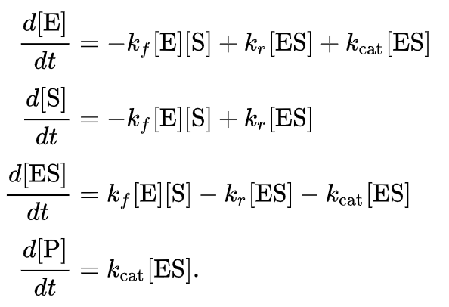
Basic Michaelis-Menten enzyme kinetics - Derivation
https://en.wikipedia.org/wiki/Michaelis%E2%80%93Menten_kinetics
Notes:
Take home: In some concentration spans, there is a large effect and in some, there is nearly no effect of delta[S]

Slide 10
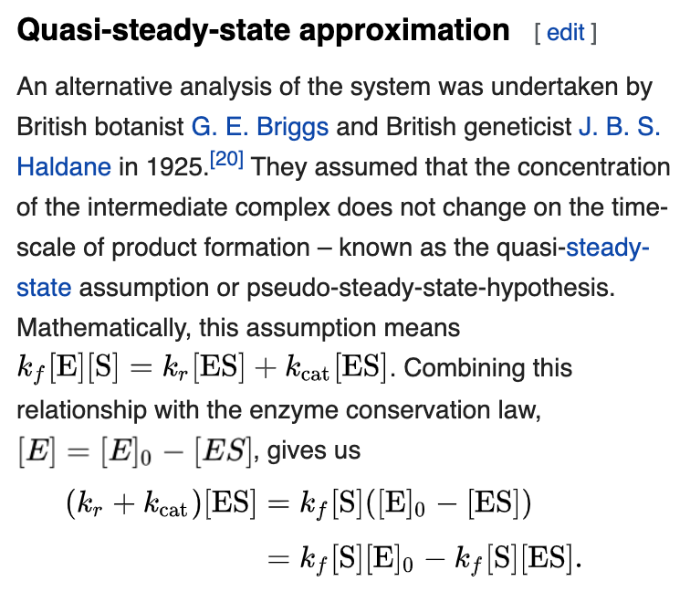
Basic Michaelis-Menten enzyme kinetics - Derivation (QSSA)
https://en.wikipedia.org/wiki/Michaelis%E2%80%93Menten_kinetics
Notes:
Take home: In some concentration spans, there is a large effect and in some, there is nearly no effect of delta[S]

Slide 11
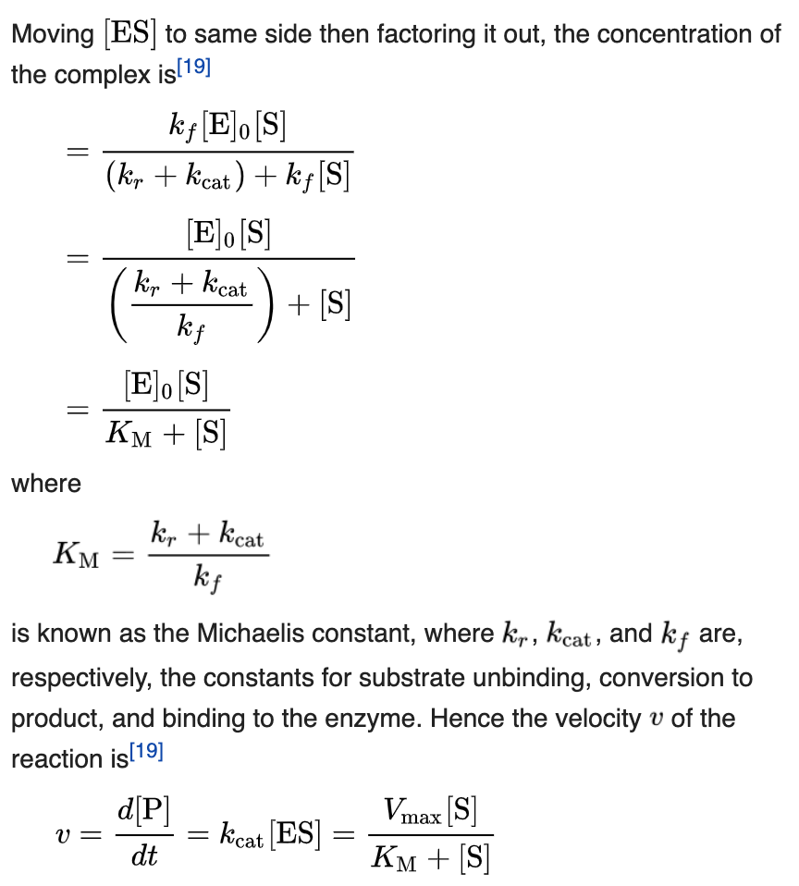
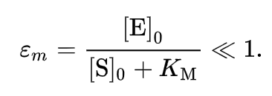
Basic Michaelis-Menten enzyme kinetics - Derivation (QSSA)
https://en.wikipedia.org/wiki/Michaelis%E2%80%93Menten_kinetics
Notes:
Take home: In some concentration spans, there is a large effect and in some, there is nearly no effect of delta[S]

Slide 12
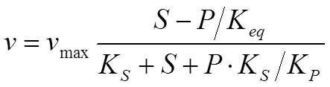
Basic Michaelis-Menten enzyme kinetics - The reversible reaction
If the enzymatic reaction of before:
takes place in both directions (reversibility), it can be derived that the rate of the reaction v is:
Summarizing: The rate of an reaction is influenced by the kinetic parameters (K and V_{max}) as well as substrate and product concentrations
k₋₂
Notes:
Discuss the equation
Ks is the Km for the substrate (Kms)
Kp is the Km for the product (Kmp)

Slide 13
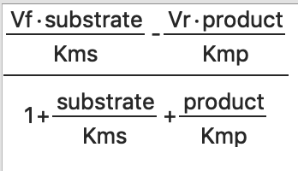
Basic Michaelis-Menten enzyme kinetics - The reversible reaction
If the enzymatic reaction of before:
takes place in both directions (reversibility), it can be derived that the rate of the reaction v is:
Summarizing: The rate of an reaction is influenced by the kinetic parameters (K and V_{max}) as well as substrate and product concentrations
k₋₂
Notes:
Discuss the equation
Ks is the Km for the substrate (Kms)
Kp is the Km for the product (Kmp)

Slide 14
Basic Michaelis-Menten enzyme kinetics - What does this all mean??
This is very relevant to cell factory engineering:
Nearly all cellular reactions are catalyzed by enzymes
Most reactions in the cell are reversible
Enzyme kinetics is the driver of metabolic reactions
Understanding how enzymes interact through their metabolites is key to engineering pathways
Notes:
Take home message, flux/rate depends on Enzyme concentration/activity, metabolites and other parameters (rate constants, vmaxes, Keqs etc.)

Slide 15
Questions?

Slide 16
Metabolic Control Analysis

Slide 17
Basic Michaelis-Menten enzyme kinetics - What does all this mean??
This is very relevant to cell factory engineering:
Nearly all cellular reactions are catalyzed by enzymes
Most reactions in the cell are reversible
Enzyme kinetics is the driver of metabolic reactions
Understanding how enzymes interact through their metabolites is key to engineering pathways
MCA is the tool to understanding the control of flux in a pathway. Enzyme kinetics is the prerequisite to MCA!
Notes:
Take home message, flux/rate depends on Enzyme concentration/activity, metabolites and other parameters (rate constants, vmaxes, Keqs etc.)

Slide 18
Metabolic Control Analysis - What is it?
A mathematical framework to understand the control of fluxes
MCA looks at the interactions between metabolites and enzymes and how it influences flux.
Separate from MFA: MFA measures and calculates the sizes of fluxes, MCA quantifies what controls the fluxes.
MFA is thus diagnostic/a characterization tool
MCA directly hints at targets for optimization of fluxes.
Applicable only to steady-state

Slide 19
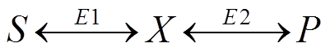
Metabolic Control Analysis - Framework
We are looking at systems of the following kind:
System parameters are the concentrations of the substrate and product S and P, and the enzymatic activities E1 and E2.
System variables are what can be determined from these, e.g. the flux J from S to P and the concentration of intermediate X.
Note that we are only looking at steady state!
Notes:
MFA was discussed in lecture 3!

Slide 20
Concentration Control (Visual)
Steady-state Reaction
Metabolite
Notes:
Take home: In some concentration spans, there is a large effect and in some, there is nearly no effect of delta[S]

Slide 21
Concentration Control (Visual)
At which concentration does the metabolite exhibit greater control over the rate? A or B?
Discuss.
Steady-state Reaction
A
B
Metabolite
Notes:
Take home: In some concentration spans, there is a large effect and in some, there is nearly no effect of delta[S]

Slide 22
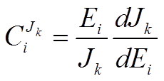
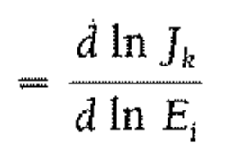
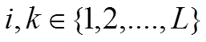
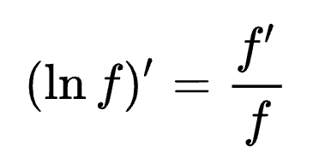
Metabolic Control Analysis - Flux Control Coefficients (FCCs)
The FCCs allows the determination of which enzymatic steps are controlling the flux J_{k} through step k of a pathway with L steps.
The flux-control summation theorem states that:
i
(eq. 11.3)
https://en.wikipedia.org/wiki/Logarithmic_derivative
Notes:
Or in other words: How much does the flux change with changes in the individual enzyme concentrations
Draw this on the whiteboard. J as a function of E, bent plot
Discuss how the magnitude of the FCC changes if an E is low, versus high
For linear PWs, all FCCs are positive. For branched, it can be negative

Slide 23
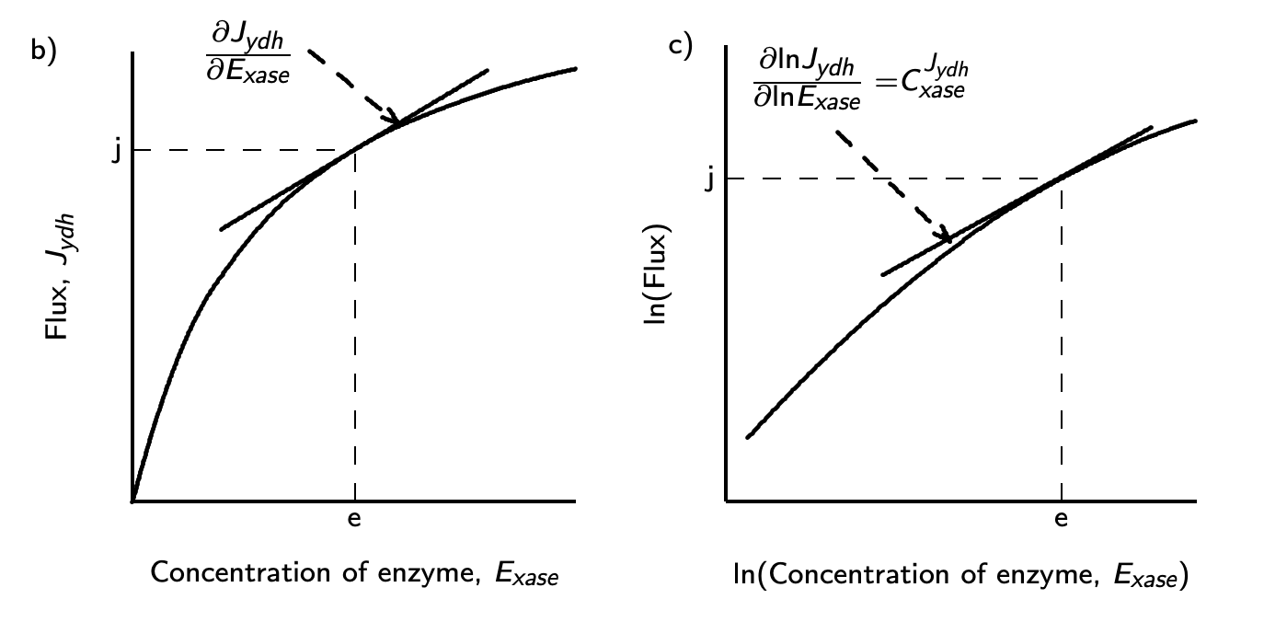

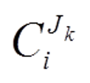


Flux Control Coefficients (visual)
k
i
k
i
k
)

Slide 24
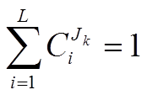
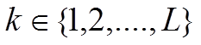
Metabolic Control Analysis - Flux Control Coefficients (FCCs)
The FCCs allows the determination of which enzymatic steps are controlling the flux J_{k} through step k of a pathway with L steps.
The flux-control summation theorem states that:
i.e. that the control on a specific flux J_{k} is distributed across all k steps of the pathway.
(eq. 11.3)
(eq. 11.6)
Notes:
Or in other words: How much does the flux change with changes in the individual enzyme concentrations
Draw this on the whiteboard. J as a function of E, bent plot
Discuss how the magnitude of the FCC changes if an E is low, versus high
For linear PWs, all FCCs are positive. For branched, it can be negative

Slide 25
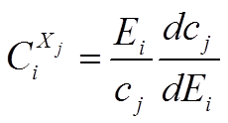
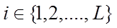
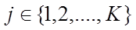
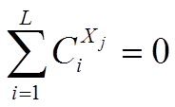
Metabolic Control Analysis - Concentration Control Coefficients (CCCs)
The CCCs examines how the metabolite concentration of metabolite X_{j} (c_{j}) is affected by enzyme activity E_{i} (v_{i}). We have a pathway with L steps and K intermediate metabolites.
The concentration control summation theorem states that:
i.e. that for each metabolite, at least one enzyme must have negative control.
(eq. 11.8)
(eq. 11.10)
Notes:
How does intermediate concentrations change, when enzyme concentrations change?
Use a pathway on the whiteboard to discuss this. E.g. C^X_2 will be negative as the concentration of X will go down as E2 goes up.
Draw a table showing this with X1 going down, and R1-2 horizontally
Draw a table showing this with X1 and X2 going down, and R1-3 horizontally

Slide 26
Live exercise
Metabolic Control Analysis

Slide 27
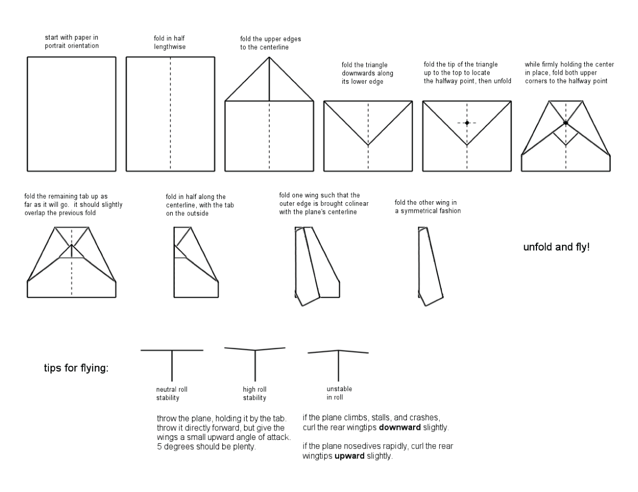
Live exercise (previous years)

Slide 28
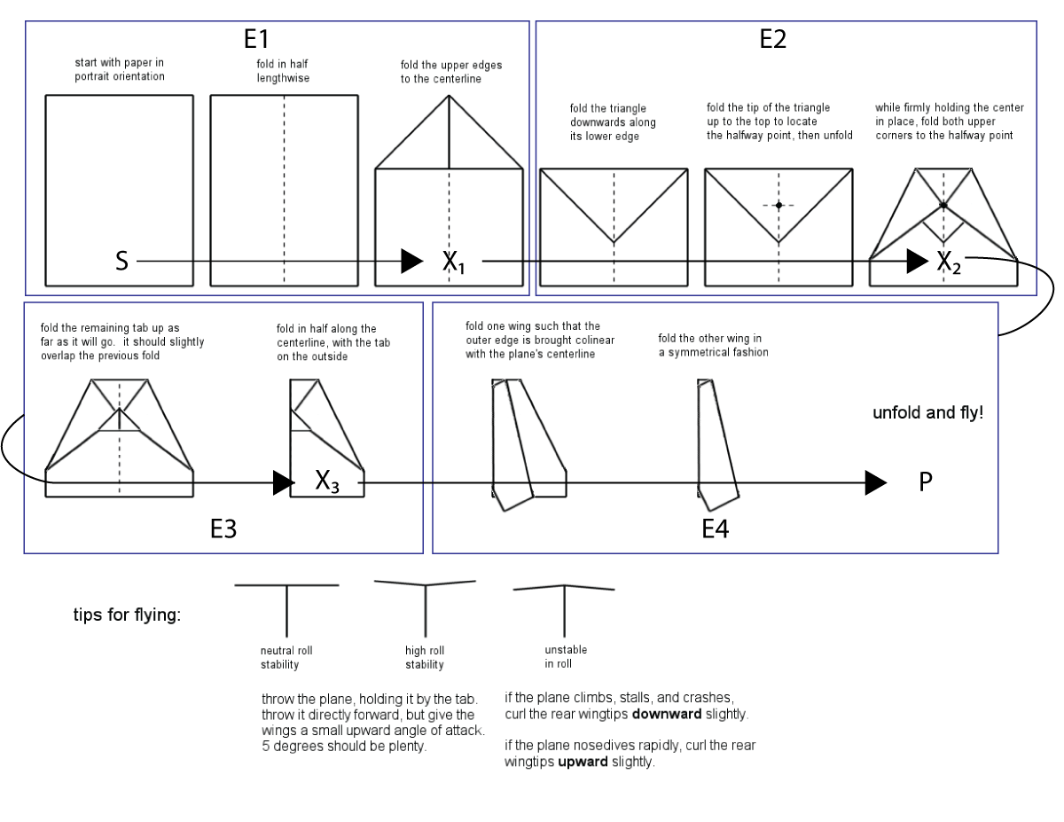
Live exercise (previous years)

Slide 29
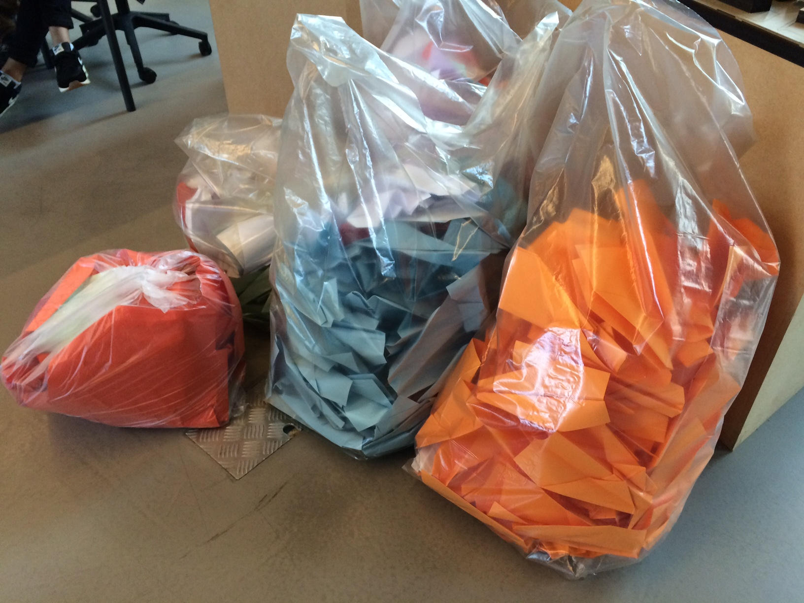
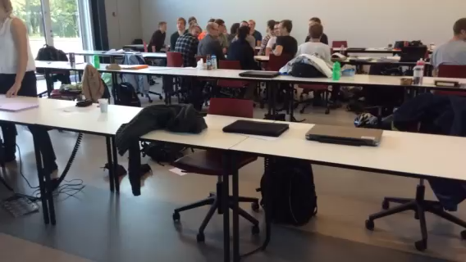
Live exercise (previous years)
… but bad for the environment
Fun …

Slide 30
E1
X1
E2
X2
E3
X3
E4
P
Part one
MCA!
1. Head
1. Mouth
1. Eyebrows
1. Color iris
GSM!
2. 1st eye
.
.
.
2. Ears
.
.
.
2. Hair
.
.
.
Bananas!
2. Callout!
MCA!
.
.
.
3. 2nd eye
3. Nose
2. Iris
2. Shrink
MCA!
2 students
2 students
2 students
2 students

Slide 31


LEGOzymes (concept)
E1
(2 students)
E2
(2 students)
E3
(2 students)
E4
(2 students)
Final product P
X1
X2
X3
E5
(2 students; breakdown & redistribute bricks; take care of counting)

Slide 32
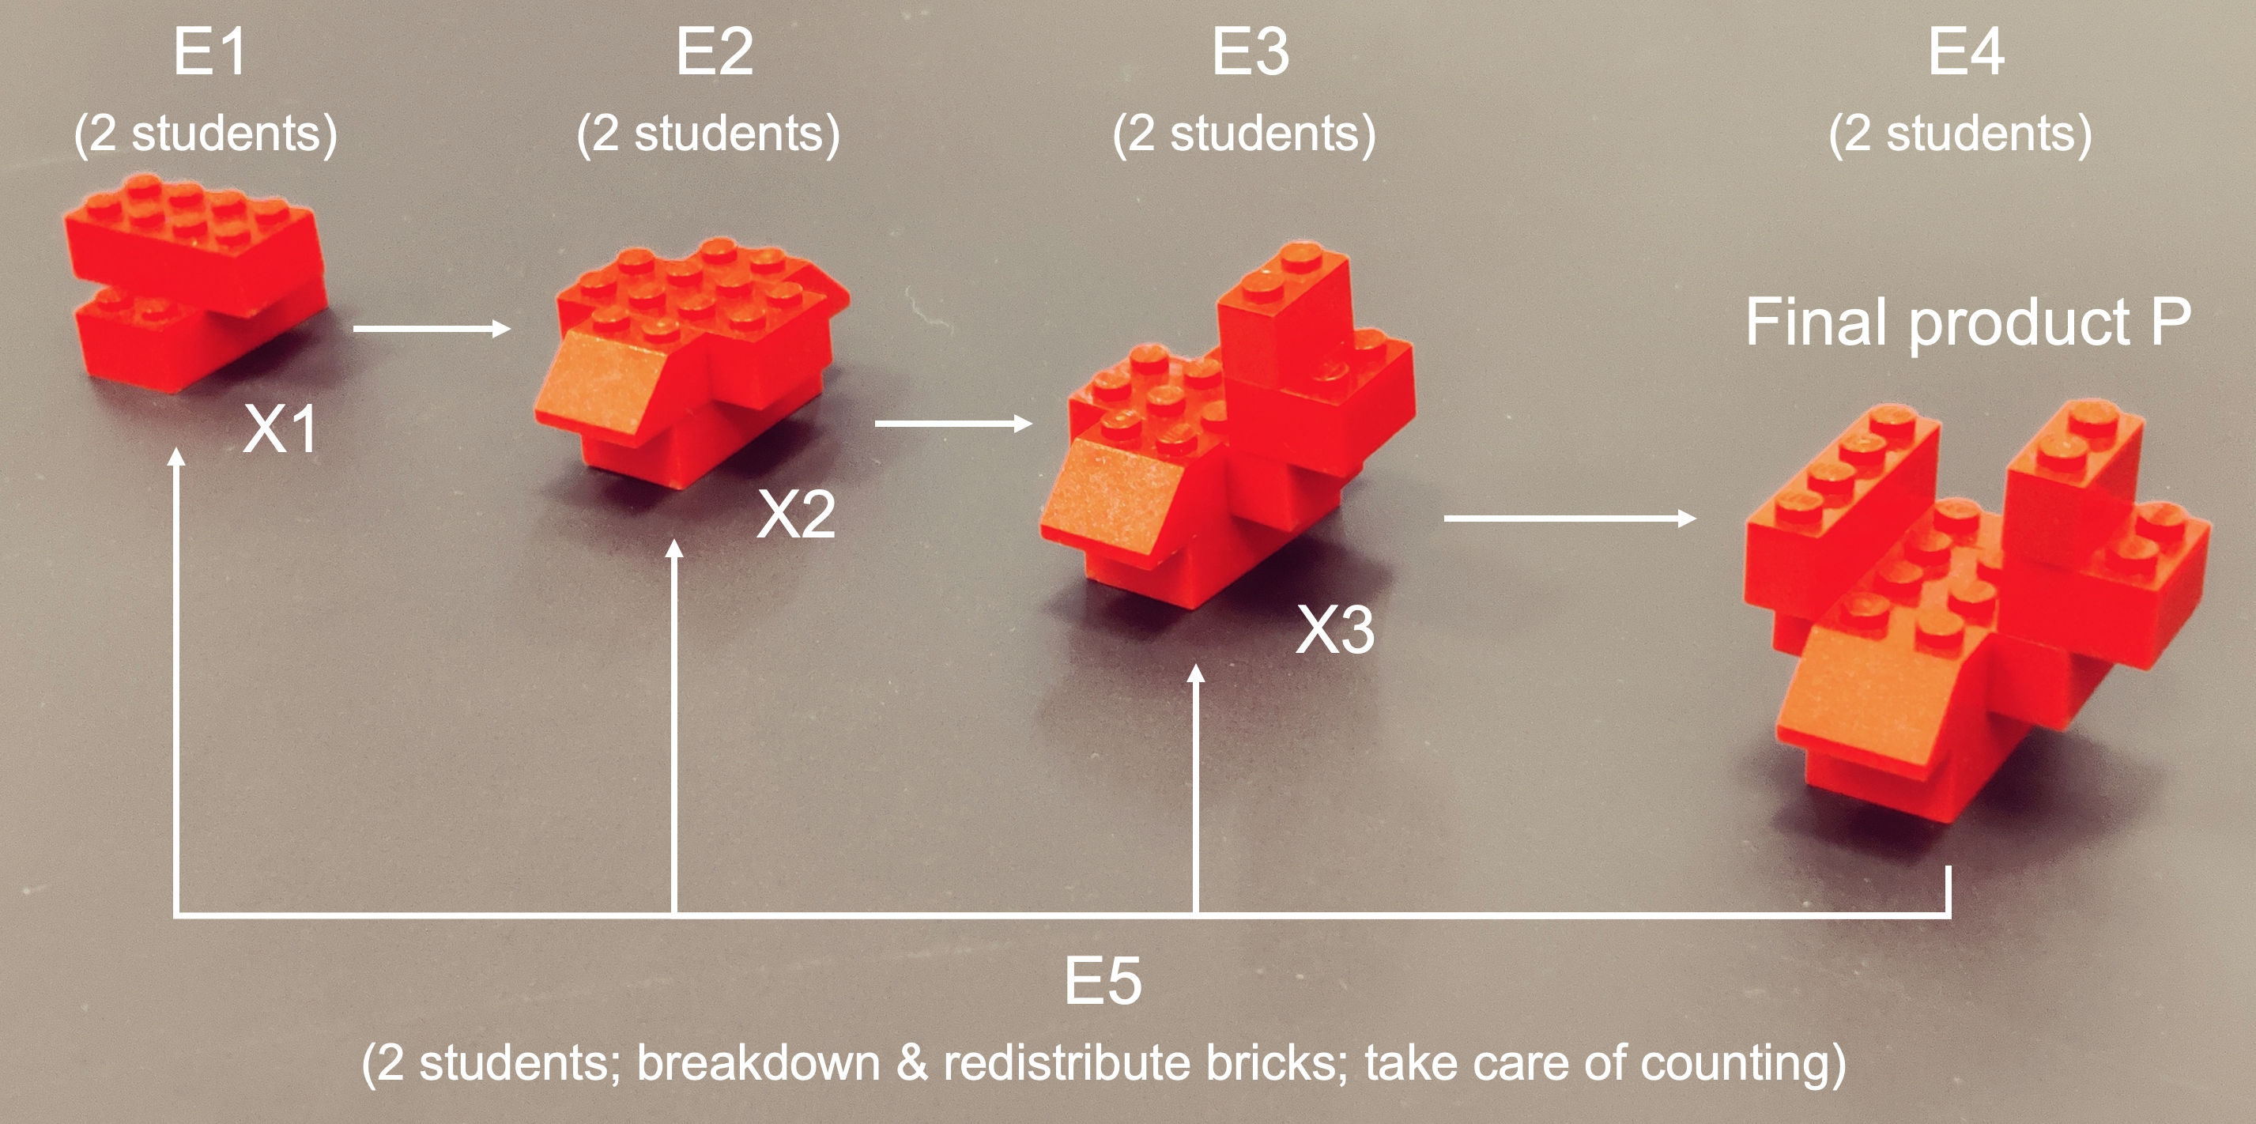
LEGOzymes setup
We will have teams of 10 people
2 people are one enzymatic activity each (E₁-E₅)
There will be an initial round of 5 minutes for everone to get acquainted and to achieve steady state so to speak
After this point, we will record concentrations of X₁-X₃ and flux J.
With this, we will discuss FCCs and CCCs
We will have 4 runs in total, and whoever gets the highest flux in round 4 wins a not at all insignificant prize!

Slide 33

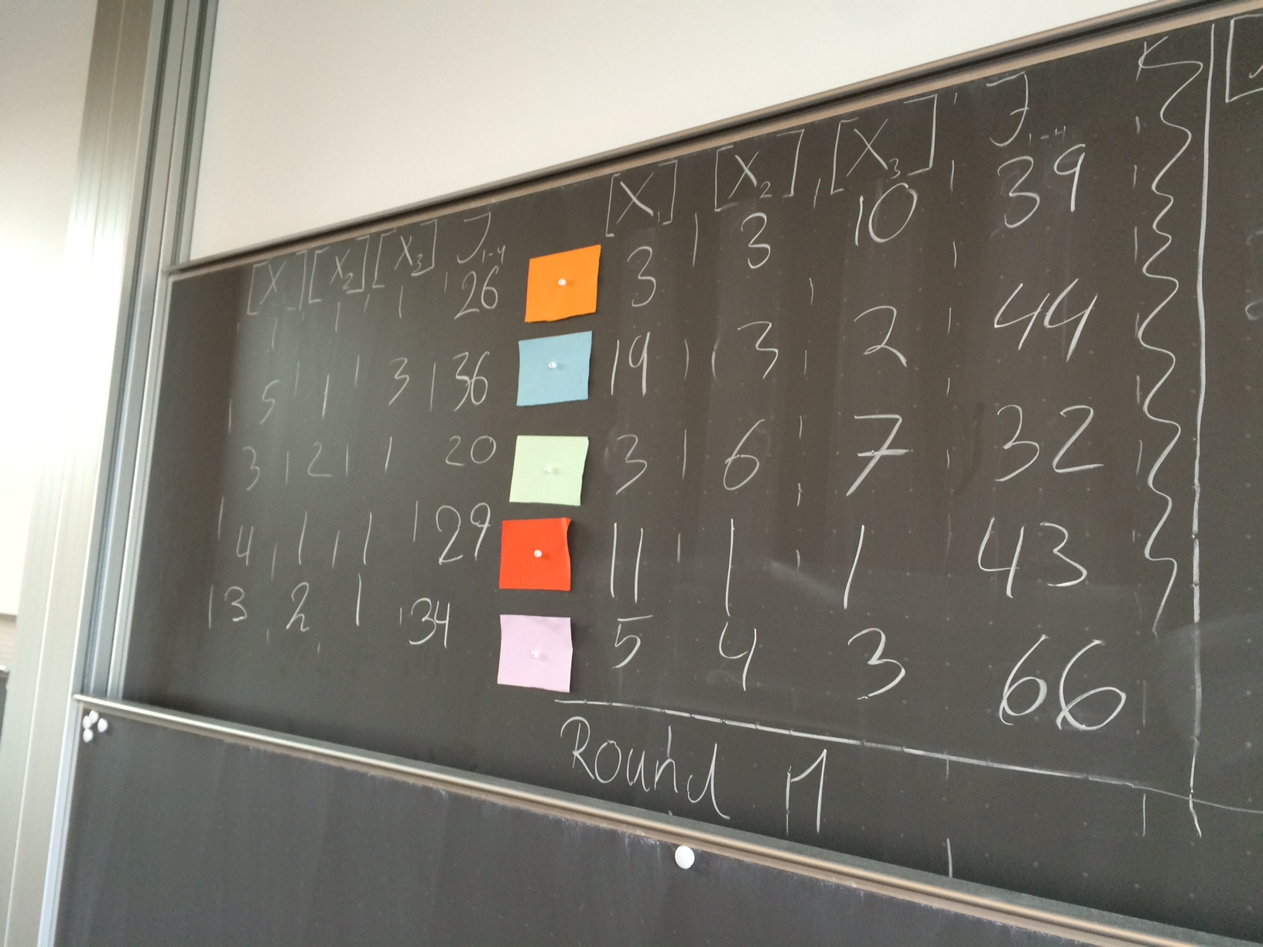

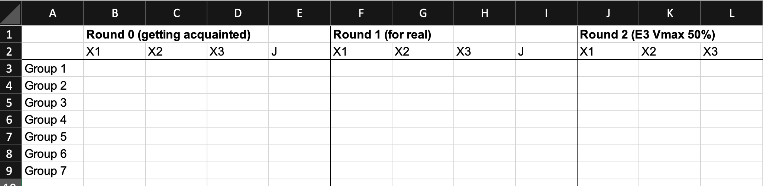
Score board example

Slide 34
LEGOzymes: 1st round (basic)
E1
(2 students)
E2
(2 students)
E3
(2 students)
E4
(2 students)
Final product P
X1
X2
X3
E5
(2 students; breakdown & redistribute bricks; take care of counting)

Slide 35
LEGOzymes: 2nd round (reducing Vmax_{E3} by 50%)
E1
(2 students)
E2
(2 students)
E3
(1 student)
E4
(2 students)
Final product P
X1
X2
X3
E5
(2 students; breakdown & redistribute bricks; take care of counting)

Slide 36

LEGOzymes: 3rd round (Feedback inhibition)
E1
(2 students)
E2
(2 students)
E3
(2 students)
E4
(2 students)
Final product P
X1
X2
X3
E1 can only proceed if X3 <= 1
E5
(2 students; breakdown & redistribute bricks; take care of counting)

Slide 37
LEGOzymes: 4th round (free optimization; win the prize!)
E1
(?? students)
E2
(?? students)
E3
(?? students)
E4
(?? students)
Final product P
X1
X2
X3
E5
(?? students; breakdown & redistribute bricks; take care of counting)

Slide 38
Wrap up
Is the LEGOzymes a good analogy for a metabolic pathway? What are the limitations?
Discuss!

Slide 39
Dynamic Flux Balance Analysis

Slide 40
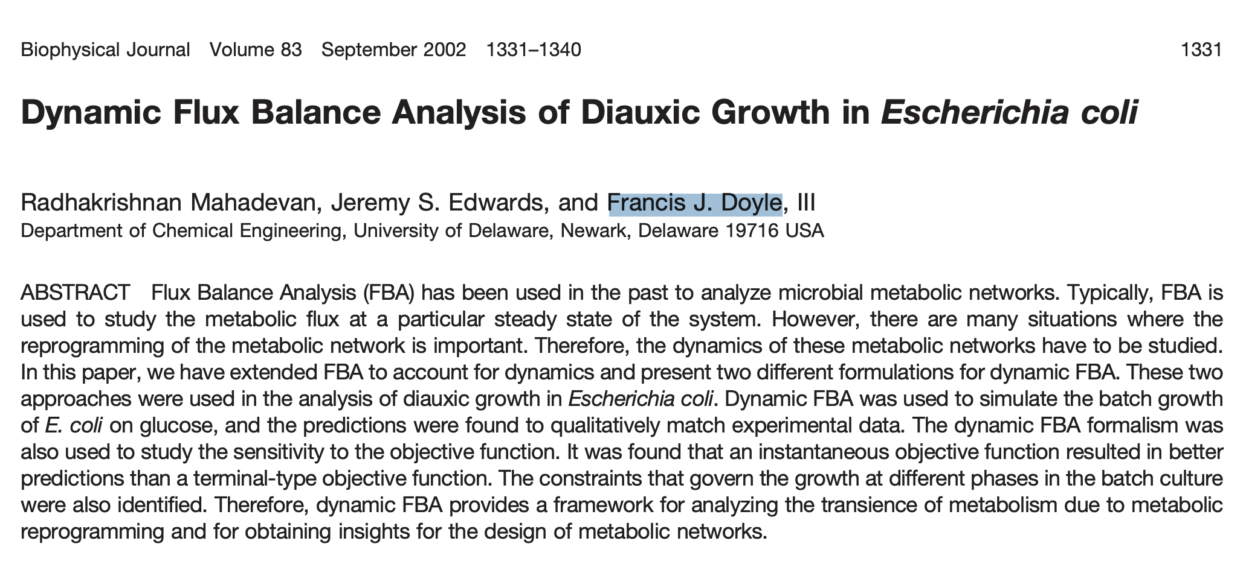
Dynamic Flux Balance Analysis (dFBA)

Slide 41
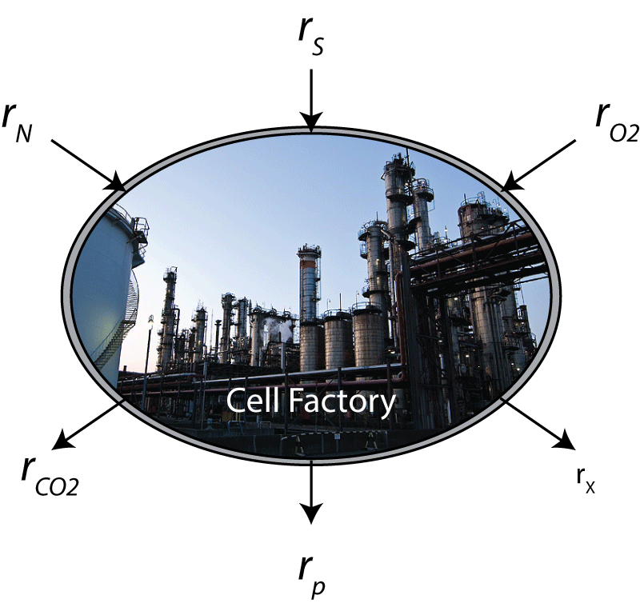
Concept of dFBA
or more complicated rate equations with inhibition terms etc.
S
e.g.
N
O₂
Pseudo-steady
State
Dynamic environment
CO₂
X
P

Slide 42
dFBA simulations
Simulate GSM model to obtain flux solution
e.g.
S
N
O₂
Update medium and biomass based on flux solution
1. Initial conditions/concentrations for external metabolites/biomass (S, N, X, …)
Pseudo-steady
State
e.g.
Dynamic environment
CO₂
X
P
Update exchange reaction bounds based on updated medium
Rinse and repeat …
e.g.

Slide 43
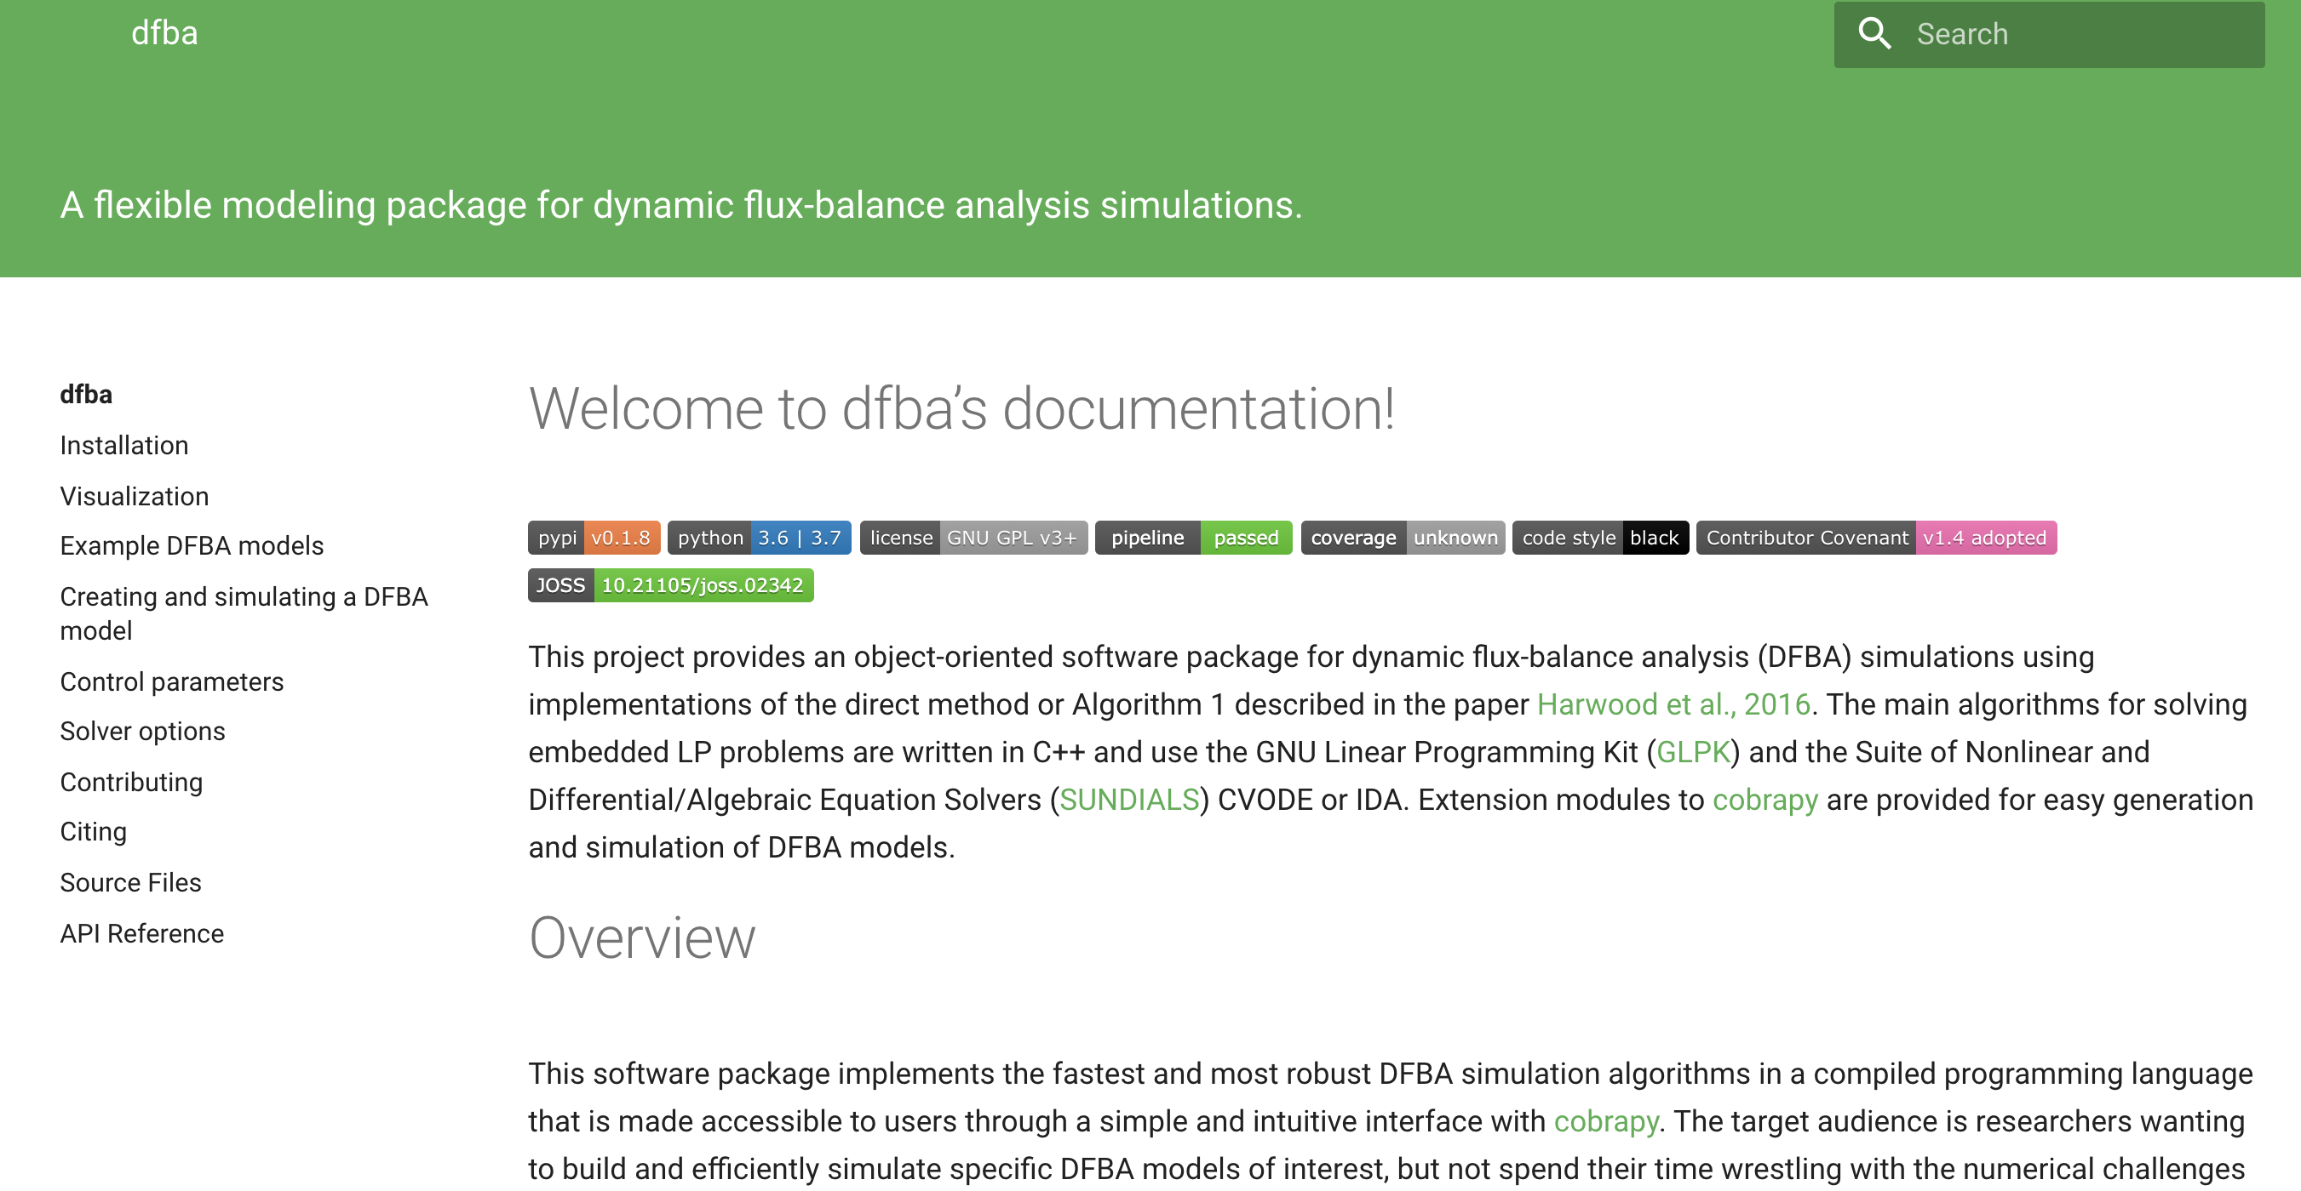
https://dynamic-fba.readthedocs.io/en/latest/

Slide 44
Learning objectives
After this lecture, you will be able to:
Discuss how Michaelis-Menten kinetics affect the metabolic flux through an enzymatic reaction.
Describe the use of Metabolic Control Analysis on a single metabolic pathway
Define the Flux Control Coefficient (FCC) (eq. 11.3) and the Flux Control Summation theorem (eq. 11.6) and explain verbally what that implies for a linear metabolic pathway.
Define the Concentration Control Coefficient (CCC) (eq. 11.9) and the Concentration Control Summation theorem (eq. 11.10) and explain verbally what that implies for a linear metabolic pathway.
Explain the general concept of Dynamic Flux Balance Analysis (DFBA) and how to apply it to model and simulate a batch cultivation

Slide 45
Questions?

